Slide 1

Mini Project (ID102B)
Even semester(2024-2025)
Monika Tyagi (202410116100123)
Mukul Dhiman(202410116100126)
Minakshi Tomar(202410116100119)
Healthcare Service Provider System
Project Supervisor:
Ms. Shruti Aggrawal
Assistant Professor

Slide 2
Introduction
This system aims to streamline healthcare services, improve patient care, and enhance communication between doctors, patients.
Built with a user-centric approach, the platform integrates features such as patient registration, appointment scheduling, diagnostics, and treatment planning into a single, unified system.
Store and organize patient information, including medical history, diagnoses, and treatment plans, in one secure place.
Schedule Appointments: Allow patients to book, reschedule, or cancel appointments easily, while doctors can view and manage their schedules.

Slide 3
Existing Systems and Challenge
Existing Systems
Existing Systems Healthcare management systems have evolved significantly over the past decade. Some of the widely used systems include:
Electronic Health Records (EHRs): Systems like Epic and Cerner are used to store and manage patient data digitally.
Telemedicine Platforms: Applications like Teladoc and Amwell enable remote consultations between doctors and patients.
Challenges in Current Systems Despite their widespread adoption, existing systems face several challenges:
Fragmented Data: Patient data is often scattered across multiple systems, making it difficult to access a complete medical history.
Lack of Interoperability: Systems from different providers often cannot communicate with each other, leading to inefficiencies.
Manual Processes: Many tasks, such as appointment scheduling and record-keeping, are still done manually, increasing the risk of errors.
User Experience: Many systems have complex interfaces that are not user-friendly for doctors or patients.
Security Concerns: Data breaches and unauthorized access to patient records remain significant issues.

Slide 4
Proposed Solution
we propose a Healthcare Service Provider . This system will:
Integrate All Services: Provide a unified platform for patient management, appointments, diagnostics, and treatment plans.
Enable Real-Time Access: Use cloud-based technologies to ensure real-time data access and updates.
Focus on User Experience: Design intuitive interfaces for doctors, patients, and administrators.

Slide 5
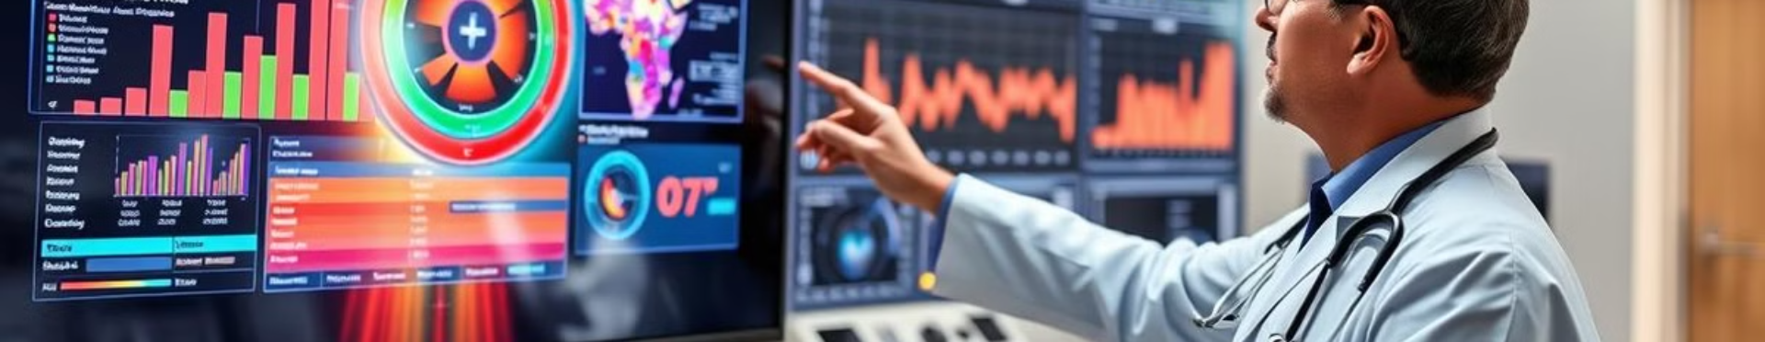
Objective of the Project
1
Develop a healthcare services provider system that provides a unified platform for patient care.
2
Enable real-time data access and analytics to empower healthcare providers with timely insights.

Slide 6
Hardware Requirements
Development Environment
Processor: Minimum Intel i5 or equivalent.
RAM: At least 8GB (16GB recommended for smoother multitasking).
Storage: Minimum 250GB SSD for faster performance.
Server Requirements
Processor: Minimum 2 CPU cores.
RAM: 4GB (8GB or more for handling higher traffic).
Client Requirements
Devices with internet access (smartphones, tablets, PCs) for accessing the healthcare services platform.

Slide 7

Software Requirements
Frontend
HTML, CSS, JavaScript for building interactive and responsive user interfaces.
Backend
Java servlet.
Database
MySQL for storing and managing patient data, appointments, and other system information.

Slide 8
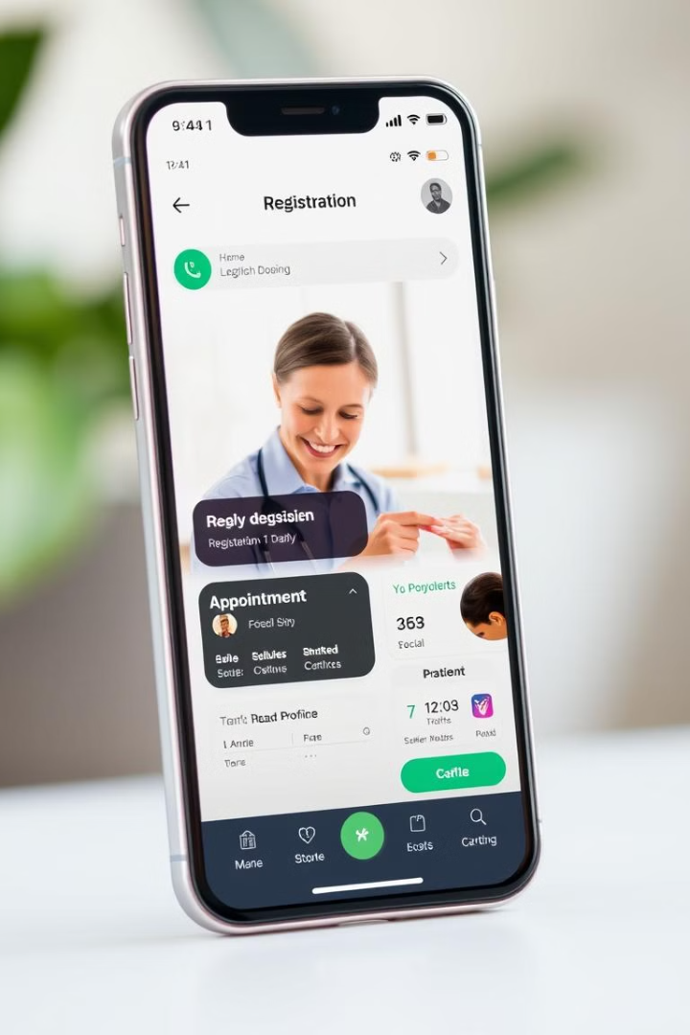

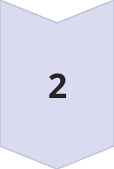

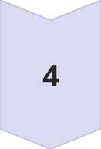
Patient Module
Registration
Patients can register for an account, providing basic information and creating a secure profile.
Login
Patients can securely log in to their accounts to access their healthcare information and services.
Profile Management
Patients can manage their personal information, including contact details, medical history, and insurance information.
Appointment Booking
Patients can easily schedule appointments with healthcare providers, view available time slots, and manage their appointment history.

Slide 9
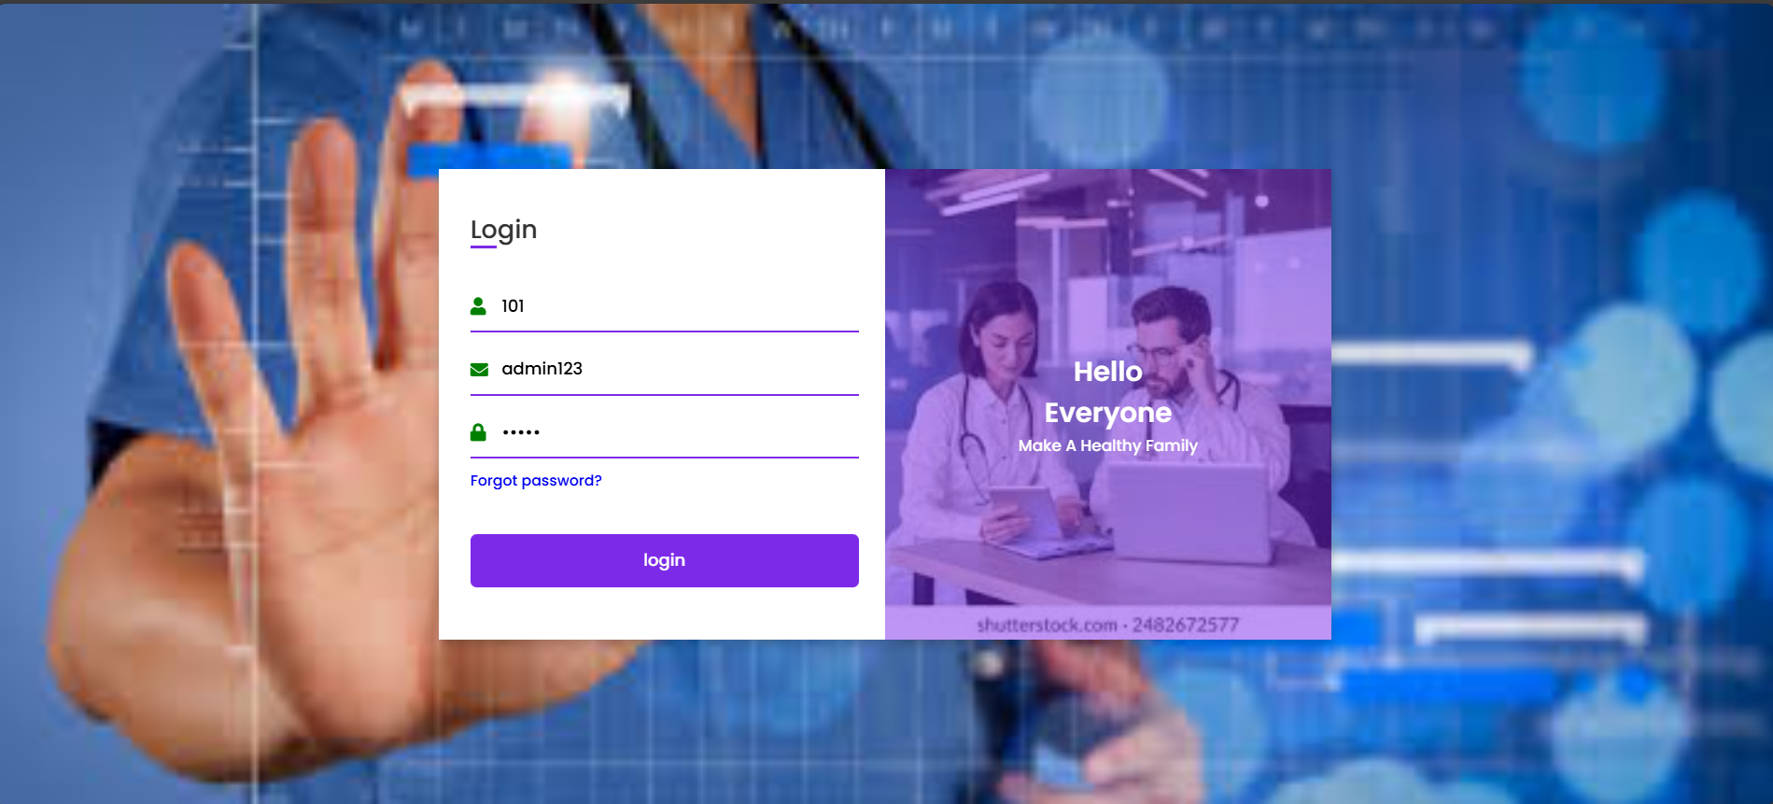
Admin Login Page

Slide 10
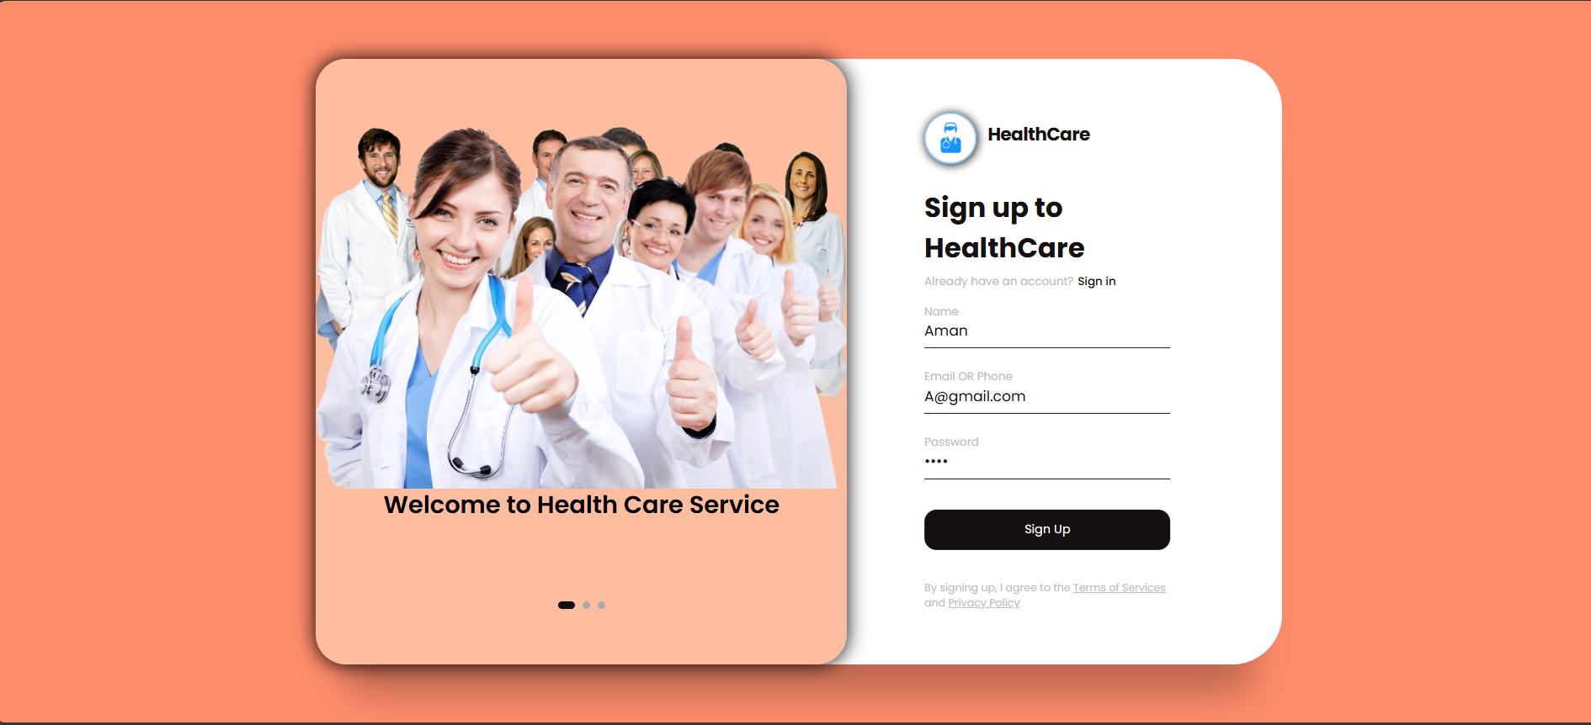
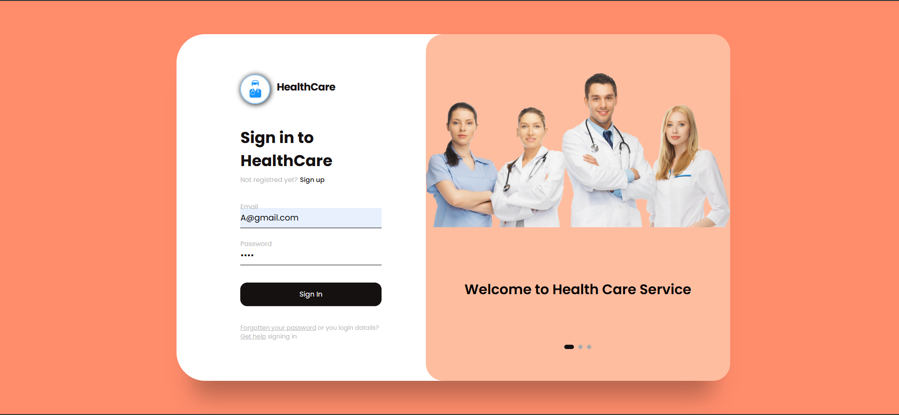
Customer Sign Up Page
Customer Sign In Page

Slide 11
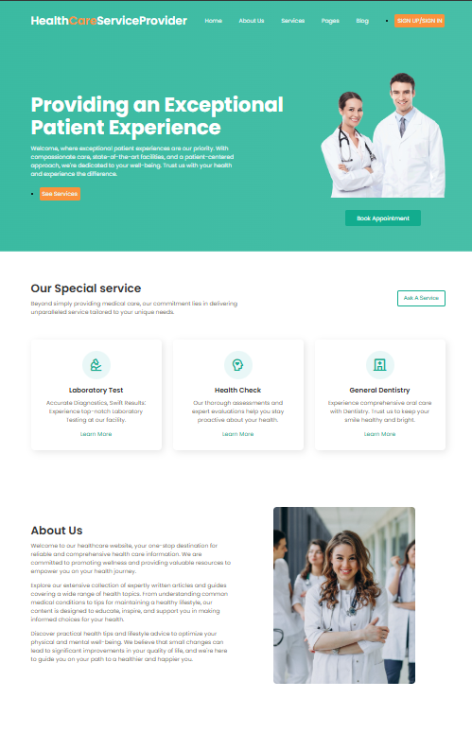
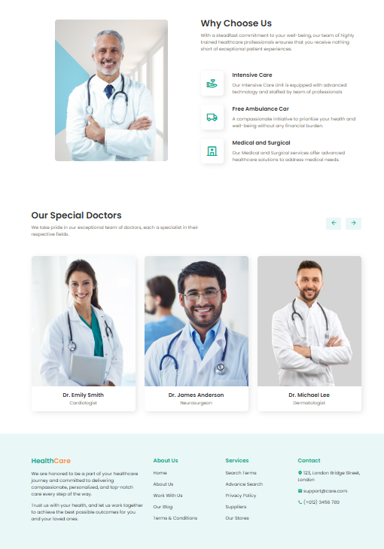
Home Page:-

Slide 12
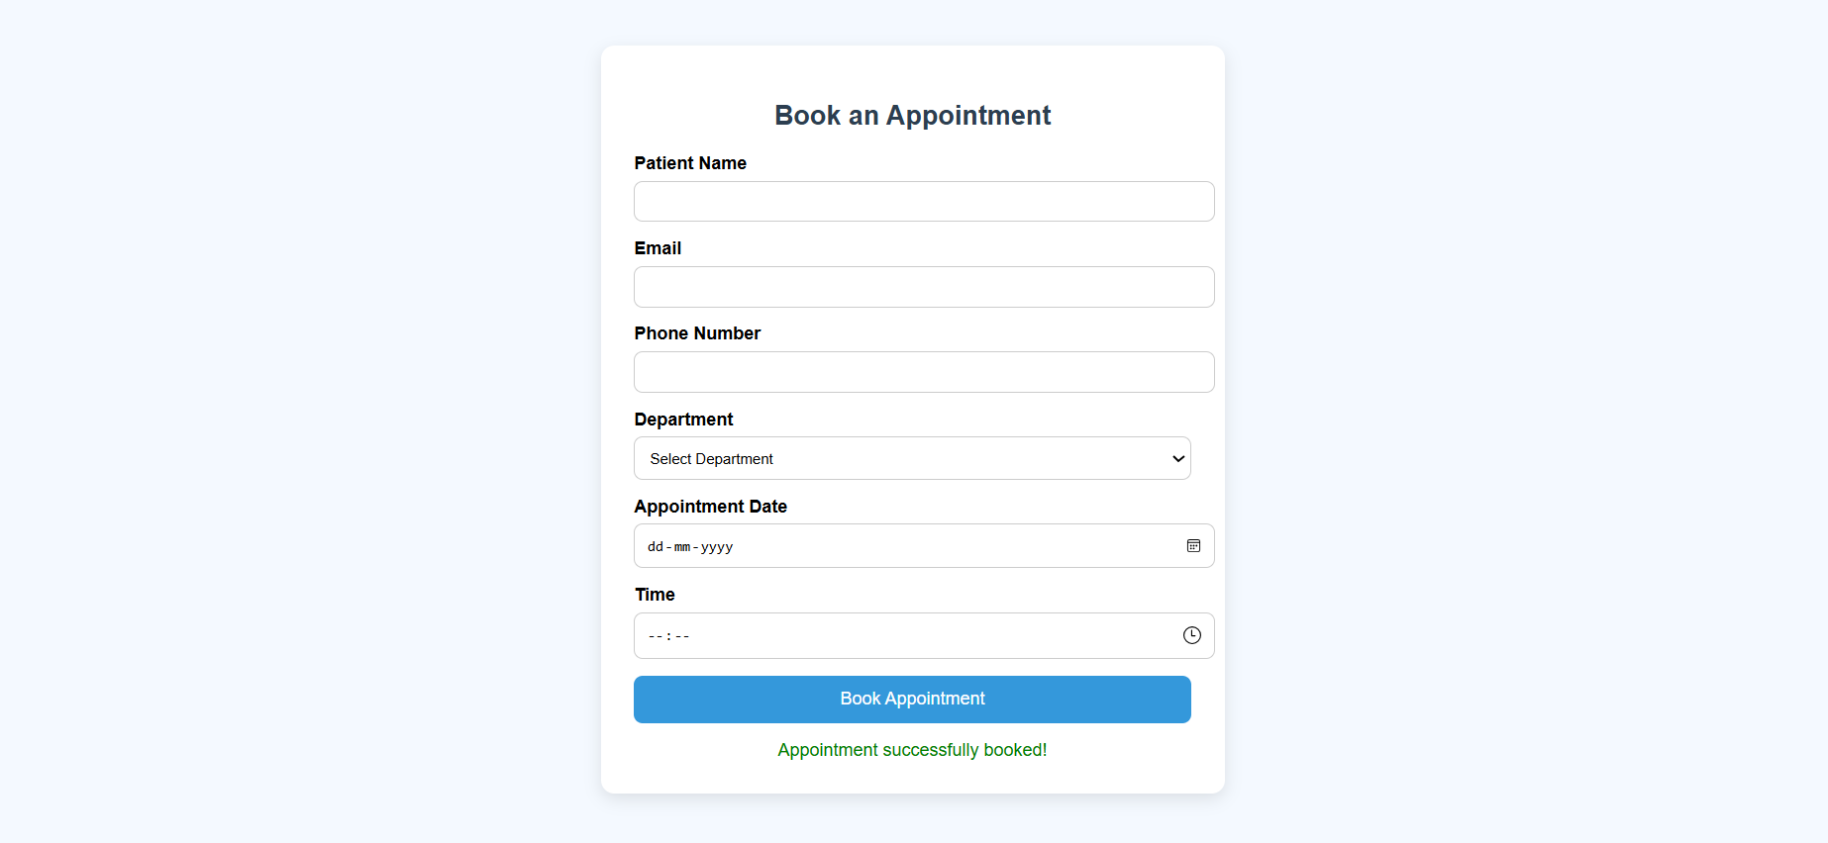
Book Appointment

Slide 13
Doctor Module
Patient Records
Diagnoses
Doctors can access and update patient medical history, diagnoses, and treatment plans.
Doctors can input diagnoses, record symptoms, and generate reports for patient records.
Treatment Plans
Doctor Qualifications
Doctors can create personalized treatment plans, prescribe medications, and track patient progress.
The module displays doctor credentials, experience, and specialization for patient trust.

Slide 14
References
HTML, CSS, JavaScript Basics
MDN Web Docs – Comprehensive and beginner-friendly.
W3Schools – Good for quick examples and reference.
Modern JS Practices
JavaScript.info
Eloquent JavaScript (free book)
🔹 Backend (Java Servlets)
Java Servlet Basics
Oracle Java Servlet Documentation
Java Brains – Servlet Tutorial (YouTube) – Practical, video-based learning.
TutorialsPoint – Servlets

Slide 15
Servlet Deployment with Apache Tomcat
Tomcat Installation Guide
Servlet Example on Tomcat (JournalDev)
🔹 Database (MySQL)
MySQL Setup and Basics
MySQL Official Docs
W3Schools MySQL Tutorial
Connecting Java Servlet to MySQL
JDBC Tutorial – Baeldung
JDBC + Servlet + MySQL Example – Real code example with connection and query.

Slide 16
Thank You

